Slide 1
Notes:
Introduce yourself
Get audience to introduce a few of themselves

Slide 2
OBJECTIVES:
What are endorphins and what are opioids?
How do nerve cells work?
Short and long term effects of abusing opioids
Notes:
Ask students about what they want to learn

Slide 3
True or False?
Prescription medications are safe because you can get them at the pharmacy
Notes:
Lets start with some true false
Collect answers – don’t give out correct answer until end

Slide 4
True or False?
Opioid medication is most effective when taken over a long period of time

Slide 5
True or False?
Using someone else’s opioid medication is okay as long as you are hurt

Slide 6
True or False?
Our brains cannot tell the difference between endorphins and opioids

Slide 7
True or False?
Opioid addiction is treatable

Slide 8
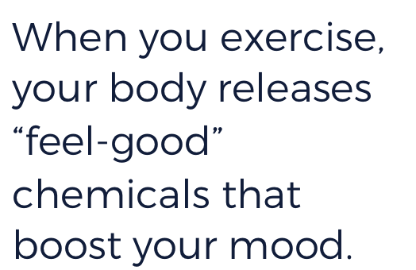
Notes:
Ask about before thoughts (expect answers like tired, sleepy, bored)
Collect after thoughts (expect answers like awake, “good,” excited)
Explain runner’s high and how going to the gym can both hurt but make you feel good

Slide 9
Like exercise, chocolate also triggers the release of “feel-good” chemicals in your brain.
Notes:
Reinforce idea that we aren’t saying eat a whole bunch of chocolate
Ask students to brainstorm other activities that might release the body’s “feel-good” chemicals.
Eating a pizza
Anyone play soccer → scoring a goal

Slide 10
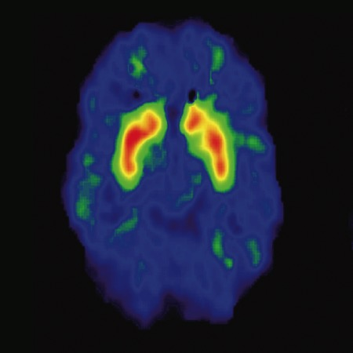
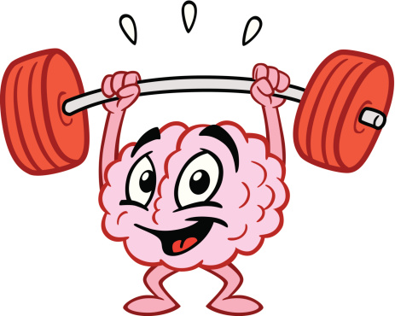
These “feel good” chemicals are called endorphins
Your nervous system produces them to reduce pain
One of the body’s neurotransmitters
These “feel good” chemicals are called endorphins.
Your nervous system produces them to reduce pain.
They are one type of neurotransmitter.
Notes:
Ask → What do you see
This is your brain → what it looks like on a scan when there is brain activity

Slide 11
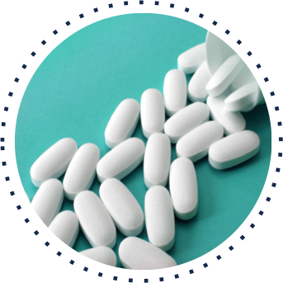
Opioids are drugs that work on the nervous system to reduce pain signals reaching the brain.
Some opioids come from the opium poppy plant. Others are made in laboratories.
Common opioids include heroin and prescription drugs like morphine, oxycodone, and hydrocodone.
Notes:
Have students give answer “what are opioids” see if they can list a few
When people take opioid drugs, they experience a euphoric rush because these drugs also affect the brain regions involved in reward. Some people may misuse opioids because they want to intensify their experience by taking the drug in ways other than those prescribed. Some people don’t use opioids to control pain. They use opioids because it gives them a relaxed, “high” feeling.
Optional: Break down the word “opioid”: first part is “opium” (a drug derived from a plant called the opium poppy) and “-oid” (meaning “like” or “similar to”).

Slide 12
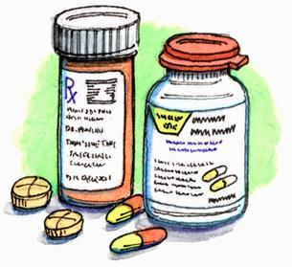
Other examples of Opioids…are they safe?
Percocet
Vicodin
Fentanyl
Dilaudid
Oxycontin
MS Contin
Codeine (Promethazine with Codeine)
Norco
Who should be using opioids:
Prescription from a legitimate doctor
Surgery/Procedures
Sports injury
Cancer
Comfort care
Nervous system
Integumentary system
Respiratory system
Circulatory system
Digestive system
Circulatory system
Notes:
See if students know what in these products
Usually its short term use (think of that true false question) but explain that for some people its going to be long term (cancer)

Slide 13
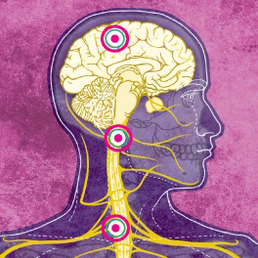
Notes:
Have student volunteers read article

Slide 14
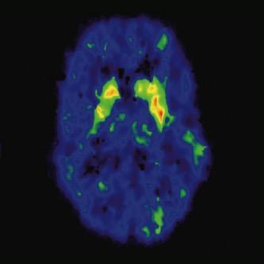
What questions do you have?
What’s the relationship between endorphins and opioids?
Why is quitting so difficult?
How does opioid misuse affect different body systems?
Notes:
Instructor Notes: As they view the image, students should note how the brains are different: the left side shows normal activation of the brain during a cognitive task. The right side shows brain activation with the influence of opioids. Activation is shown by color: red shows strongest activity, then orange, then yellow, then green. The image on the left shows strong activation in red and orange in the target area, while the image on the right shows much less and weaker activation, with only a little yellow and green.

Slide 15
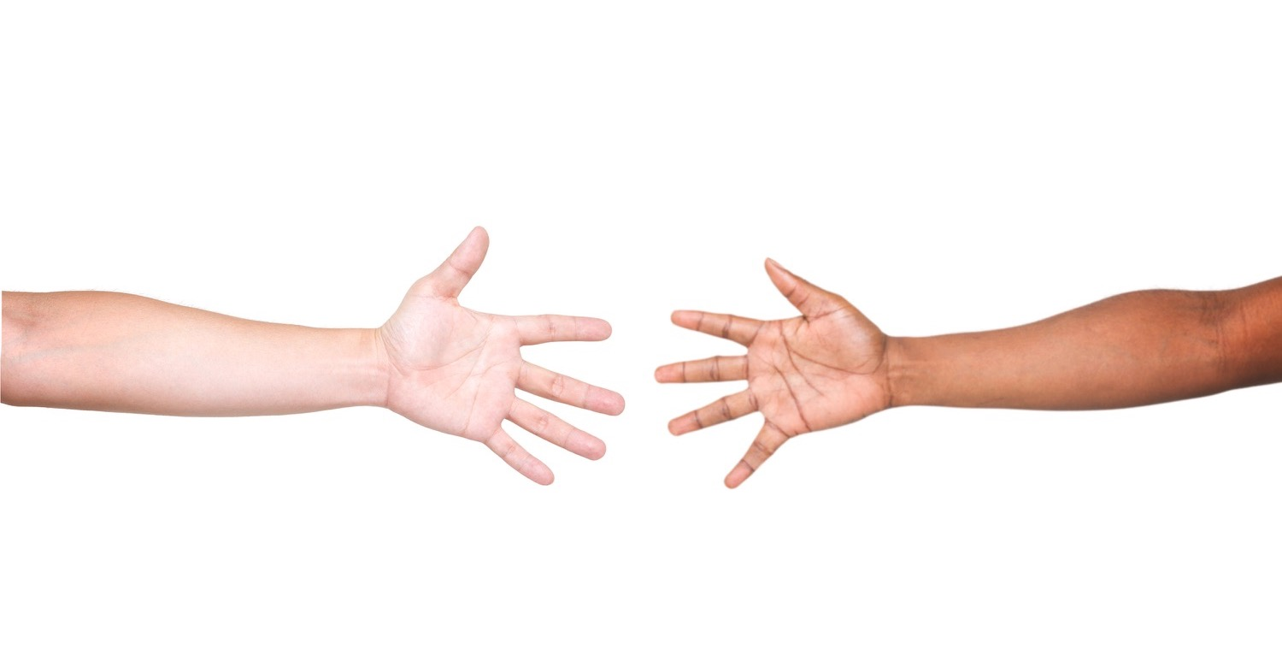
Notes:
5 volunteers
2 parts
Connect students and have them pass a message
Disconnect students and have them try to pass a message → won’t be able to → move onto next activity with same 5 volunteers

Slide 16
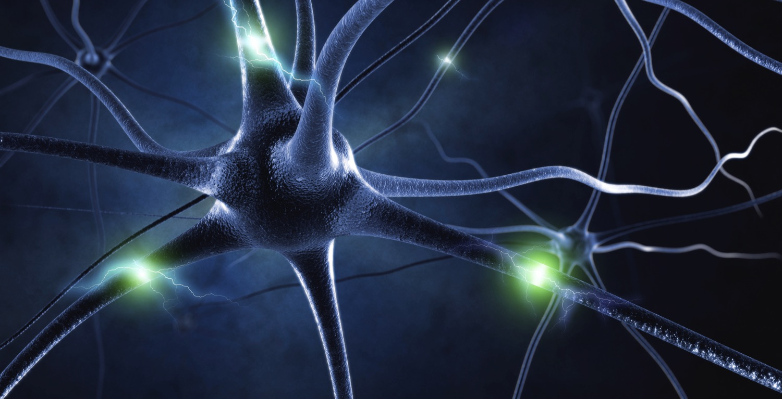
Notes:
Describe how neurons are composed of several parts: the soma (cell body), dendrites (branches), and an axon (fibers) leading to a terminal (bulb). Point to each part in the diagram. Make connections, or encourage students to do so, between their body parts in the previous model activity and the neuron. (The body is the soma, the arm is the axon, and their fingertips are the terminal.) Then, ask students to predict what each part of a neuron does.
Activity: 5 students. ABCD (1 neuron) + E(next neuron) Have ABCD collect a message, package it, send it down the axon, and have the terminal end send it to the next neuron
Once students have had a chance to explore the image, explain the purpose of each part. The branches (dendrites) receive messages from neighboring neurons. The middle (soma) processes the information. It creates an electrical signal (a major impulse called the action potential) and sends it down the fiber (axon) toward the bulb at the tip (terminal); the signal can then be transferred to the dendrites of a neighboring neuron. Use your finger or the onscreen pointer to trace this movement on the slide.

Slide 17
Notes:
Go through 5 steps
Dendrites receive information as electrochemical signals
Soma (body) processes information
Processed information travels down axon to terminal end
Terminal end releases neurotransmitters
Info is captured by next neuron via another dendrite
https://science360.gov/obj/tkn-video/0e2ab299-9dfe-4cad-b517-85ad949a67db/mysteries-brain-thinking-brain
Cut off video with approximately 1 minute remaining: when professor discusses his research. Due to time restraints.

Slide 18
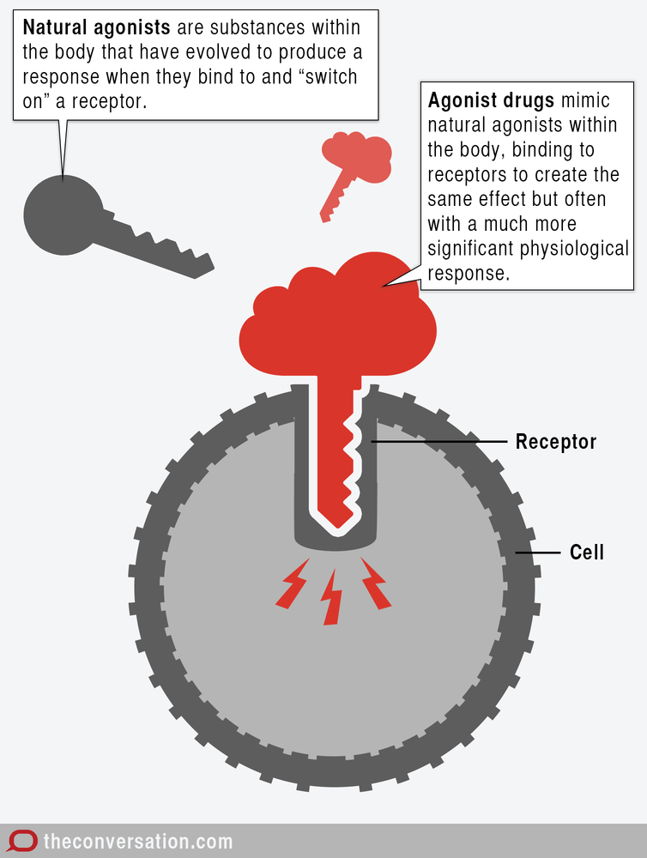
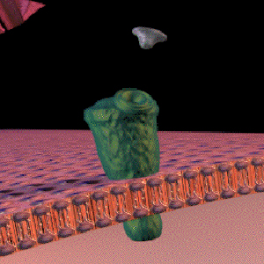
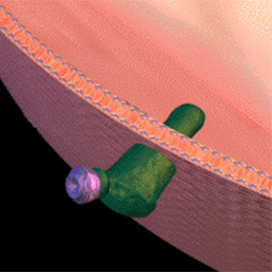
The brain cannot tell the difference!
Endorphin
Opioid
endorphin
opioid receptor
Endorphin Receptor
opioid receptor
opioid
Brain
Cell
Notes:
Click to display the images and ask students a series of questions to guide their inquiry:
What do you notice about the shape of each “key”—i.e., the natural endorphin and an opioid like morphine? (Circle the bottom section of each—i.e., the section that fits into the endorphin receptors. They are similar.)
The endorphin receptor is the “lock” from the analogy. What type of “lock” does each key fit into? (Both natural endorphins and opioid receptors fit into endorphin receptors.)
What conclusion can you draw from this relationship? (The brain cannot tell the difference between natural endorphins and opioids.)
After students have drawn their own conclusions, explain that opioids mimic the action of endorphins by fitting in the same locks (binding to endorphin receptor sites in the brain). This affects feelings of pain as well as a person’s overall emotional state. However, endorphins are not harmful or addictive like opioid drugs are. Endorphins come from positive activities such as exercising, laughing, and eating certain foods. Click the slide to display the text (“The brain cannot tell the difference!”).

Slide 19
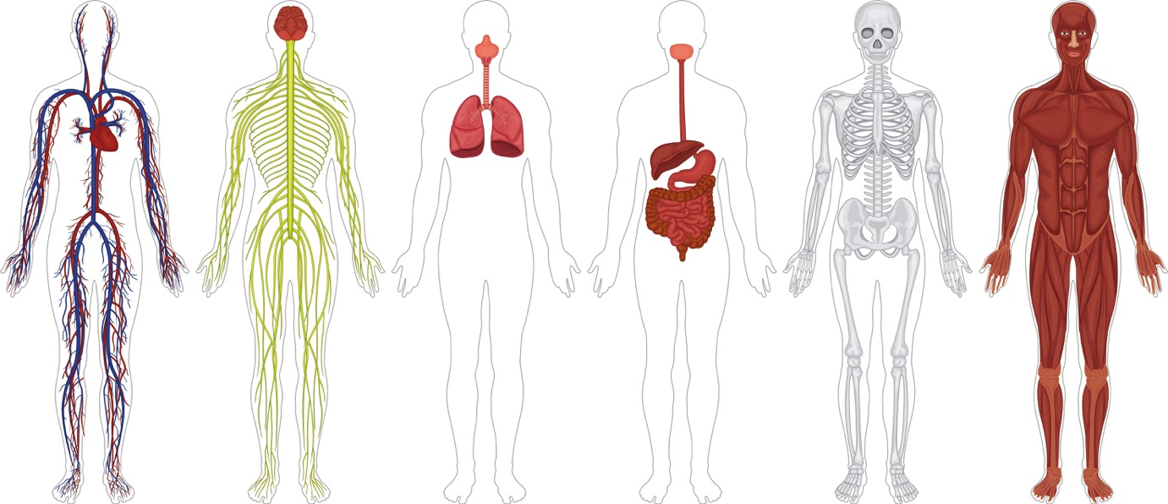
Circulatory
Nervous
Respiratory
Digestive
Skeletal
Muscular
Notes:
Circulatory: Heart pumps blood throughout body to deliver oxygen
Nervous: Responsible for sending signals to and from the brain to rest of body
Respiratory: Responsible for breathing in oxygen and exhaling CO2
Digestion: Eating, breaking down or digesting foods and removing waste
Skeletal: Function to give body its structure
Muscular: Move the body

Slide 20
Circulatory
Euphoria
“feel good”
Slowed
heart rate
Respiratory
Nervous
Warm flushing
of skin
Dry mouth
Dry mouth
Unconsciousness
Heavy feeling in fingers and toes
Nausea, vomiting & constipation
Vomiting
Severe
itching
Severe itching
Digestive
Muscular
Slowed
breathing
Bone thinning
Skeletal
Notes:
Instructor Notes: Students should be able to identify the short-term effects on the nervous system (euphoria), circulatory system (slowed heart function), respiratory system (slowed breathing), digestive system (dry mouth, nausea, vomiting), muscular system (warm flushing of the skin, heavy feeling in fingers and toes, itching), and skeletal system (bone thinning).
- Important to point out “slowed breathing” as severe and quick, leading to permanent brain injury and death, and “slowed heart rate” as leading to heart failure and death.

Slide 21
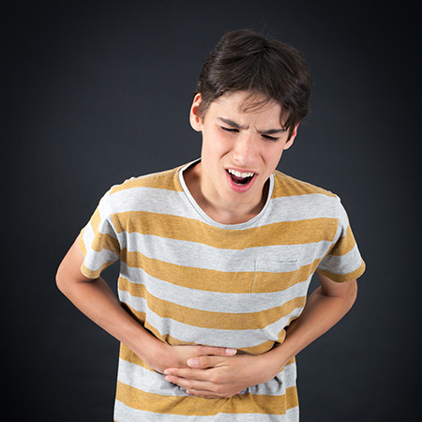
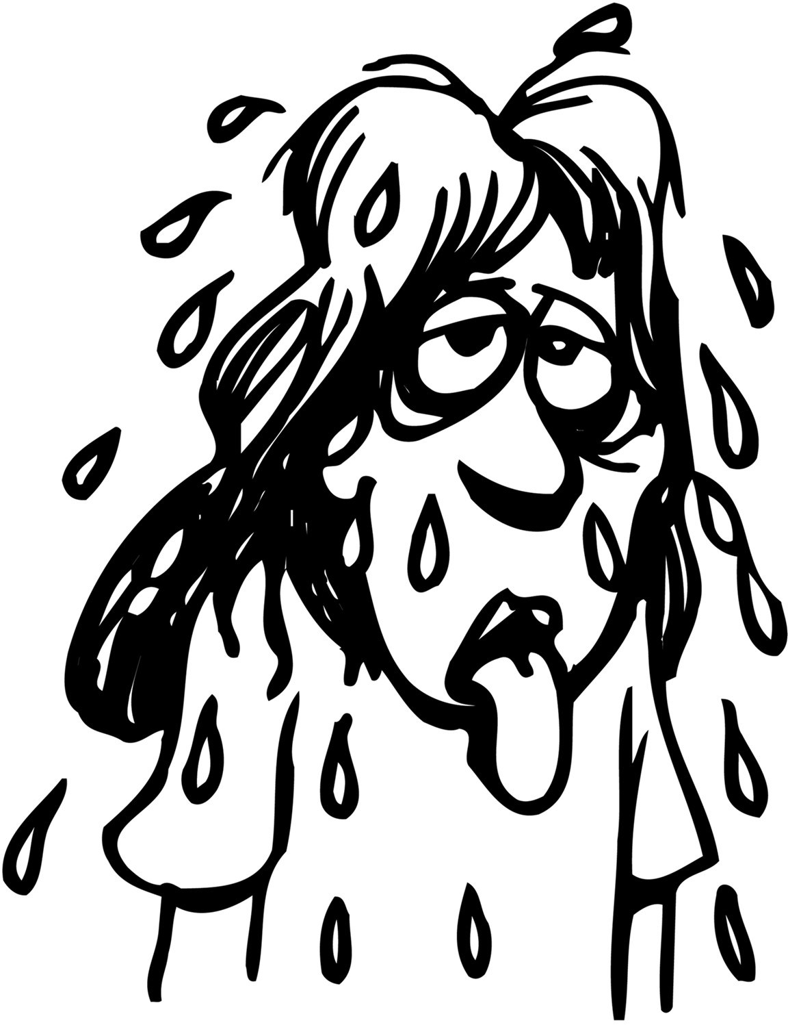
STEPS TOWARDS ADDICTION
Tolerance
When the body needs more drugs to feel same effect
Physical Dependency
When the body needs a drug to function
Symptoms include : sweating, mydriasis (dilated pupils), vomiting, tachycardia (fast heart rate), goosebumps, abdominal cramps, muscle cramps, and involuntary leg movements
Withdrawal
When the body stops drug use abruptly
Symptoms include: sweating, vomiting, fast heart rate, abdominal and muscle cramps
Notes:
Instructor Notes: Ask students if they have any routines (like brushing their teeth every morning) and how their bodies would feel if this routine were interrupted. Major withdrawal symptoms peak at 24-48 hours.

Slide 22
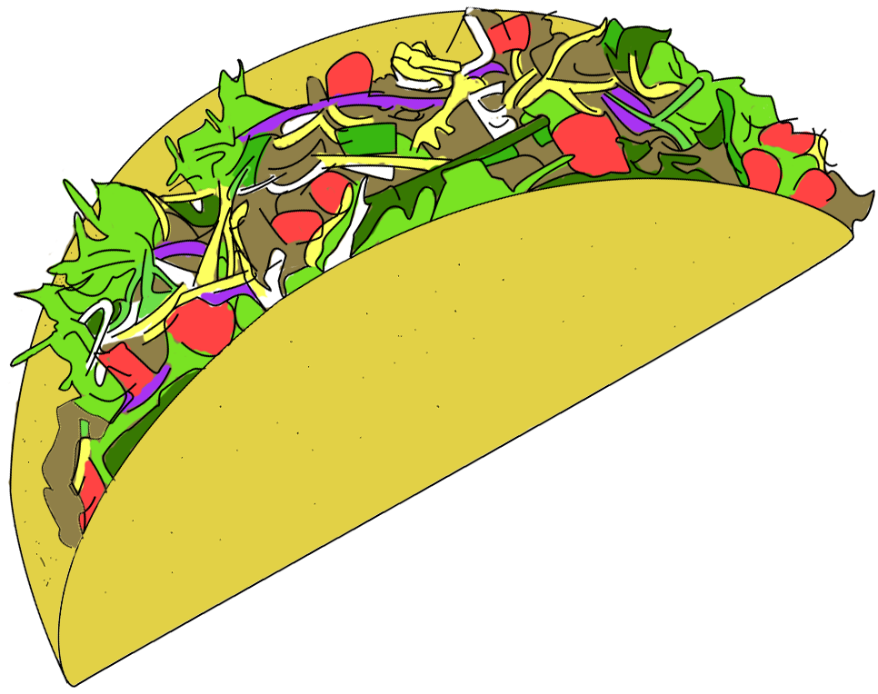
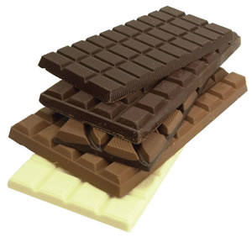
CRAVINGS
Symptoms include : sweating, mydriasis (dilated pupils), vomiting, tachycardia (fast heart rate), goosebumps, abdominal cramps, muscle cramps, and involuntary leg movements
Notes:
Here, relate physical dependency to experiencing cravings. Can’t just have that one potato chip. Addiction is like giving into your cravings: for that good feeling. Treatable condition. Explain lives of some of these addicts.

Slide 23
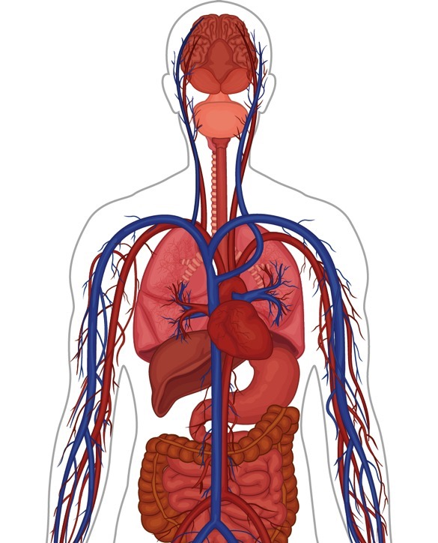
Tolerance
Physical Dependency
Nervous system
Integumentary system
Pneumonia
Respiratory system
Decreased liver function
Heart infection
Circulatory system
Digestive system
Collapsed veins
Circulatory system
Notes:
Long term refers to weeks/months/years
Students should be able to identify the long-term effects on the circulatory system (infection of heart, collapsed veins), respiratory system (pneumonia), digestive system (decreased liver function), and nervous system (tolerance, dependence).
At the end – ask what do you think is the most significant long term effect?
Why is physical dependency most significant? → require increasing amounts of drug and will suffer from withdrawal which we will talk about if they stop using the drug. They also run the risk of becoming addicted, which is when someone looks to use the drug as a compulsion.

Slide 24
Notes:
"Choices" is an animated story that captures the pressures and serious decisions facing teens around the issue of prescription drug abuse.
Running Time: 4:30
http://www.smartmovessmartchoices.org/animated-video
While watching, think about:
Which characters you can relate to
What choices would you make differently
What questions do you have or any new info you learn

Slide 25
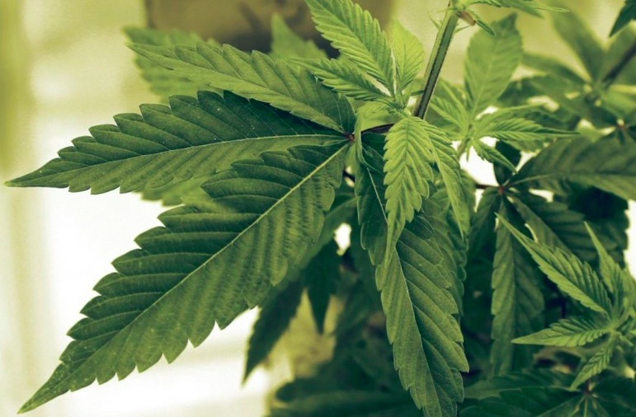
What about MARIJUANA?
- What is it?
4% → 12%
- Car accidents - IQ level
- Short-term use
- Gateway to heroin
These “feel good” chemicals are called endorphins.
Your nervous system produces them to reduce pain.
They are one type of neurotransmitter.
Notes:
Tie in to previous “choices” clip
Refers to the dried leaves, flowers, stems, and seeds from the hemp plant, Contains the mind-altering chemical delta-9-tetrahydrocannabinol (THC)
- The amount of THC in marijuana has been increasing steadily:
- 4% in 1995 to 12% in 2014
THC levels as great as 30%
Even tho legalized, causes deaths:
Two studies show decrease in grades, lower IQ
Even short-term use can lead to psychosis and schizophrenia
Gateway drug? Example heroin

Slide 26
SHORT-TERM EFFECTS
Coma
Drowsiness
“Feeling good”
Unconsciousness
LONG-TERM EFFECTS
Difficulty sleeping
Muscle and bone pain
Physical dependence
Restlessness
Tolerance
Overdose
Notes:
Instructor Notes: Ask students to imagine how a person would feel if they experienced endorphin rushes every day, multiple times per day. What would happen to the way they feel? If students have misconceptions, ask if they have ever eaten several spicy things back to back. Does the food taste less spicy over time?
Click to display this table and review each effect. Focus on physical dependence and tolerance.
Then, click to display the text below the table. Explain that an overdose is when someone takes too much of a drug and the body starts to shut down, sometimes leading to death. Overdoses are common with opioid misuse because many prescription drugs are very strong and it is difficult to determine the right amount.
Explain 2 imp points: Brain is still growing until 25 years old. These bad effects multiply in the body.

Slide 27
Notes:
Instructor Notes: Present slides 18 to 23 one at a time. Pause after each slide so that students can identify whether it shows a symptom of opioid misuse or withdrawal and identify the body system affected (nervous, respiratory, digestive, or skeletal).
The first part of the story describes the teenager experiencing euphoria from opioid misuse.
- This shows an effect on the nervous system.
- The euphoria is caused by opioid molecules locking into receptors, causing the body to release endorphins, which intensify feelings of pleasure and decrease or eliminate pain.

Slide 28
Notes:
Instructor Notes: Pause after this slide so that students can identify whether it shows a symptom of opioid misuse or withdrawal and identify the body system affected (nervous, respiratory, digestive, or skeletal).
The second part describes the teenager experiencing slowed breathing from opioid misuse.
- This shows an effect on the respiratory system.
- Opioids depress, or slow, the brain’s ability to regulate the organs that cause us to breathe.

Slide 29
“I kept taking the pills every day after school. After a while I began to feel nauseous and had trouble going to the bathroom. When my stomach starting hurting really bad, I took two pills to make the pain go away.”
Notes:
Instructor Notes: Pause after this slide so that students can identify whether it shows a symptom of opioid misuse or withdrawal and identify the body system affected (nervous, respiratory, digestive, or skeletal).
The third part describes the teenager experiencing nausea, constipation, and stomach pain from opioid misuse.
- This shows an effect on the digestive system.
- Opioids can cause nausea, constipation, and stomach pain. People can get pain from opioid misuse, and they tend to take more opioids to relieve that pain they got from misusing opioids.

Slide 30
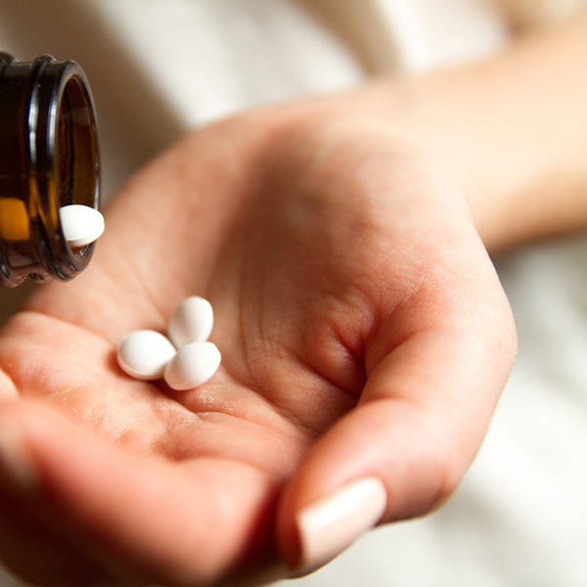
Notes:
Instructor Notes: Pause after this slide so that students can identify whether it shows a symptom of opioid misuse or withdrawal and identify the body system affected (nervous, respiratory, digestive, or skeletal).
The fourth part describes the teenager experiencing physical dependency from opioid misuse.
- This shows an effect on the nervous system.
- With frequent use, opioids wear down the “locks” (receptors) and some stop working. As a result, the person needs to take a greater amount (higher dose) to get the same pain-relieving effects.

Slide 31
Notes:
Instructor Notes: Pause after this slide so that students can identify whether it shows a symptom of opioid misuse or withdrawal and identify the body system affected (nervous, respiratory, digestive, or skeletal).
The fifth part describes the teenager experiencing difficulty sleeping from opioid withdrawal.
- This shows an effect on the nervous system.
- Opioid withdrawal can cause a variety of negative physiological effects, including pain, nausea, and twitching; any of these effects can interfere with sleep patterns.

Slide 32
“The next day during school, I couldn’t stop thinking about the pills. All my teachers looked like they knew I was taking them. I was nervous to talk to anyone, so I skipped school the next day.”
Notes:
Instructor Notes: Pause after this slide so that students can identify whether it shows a symptom of opioid misuse or withdrawal and identify the body system affected (nervous, respiratory, digestive, or skeletal).
The last part describes the teenager experiencing anxiety from opioid withdrawal.
- This shows an effect on the nervous system.
- When the body becomes physically dependent on opioids, it needs the drug to function. As a result, the absence of the drug can cause a person to feel anxious.

Slide 33
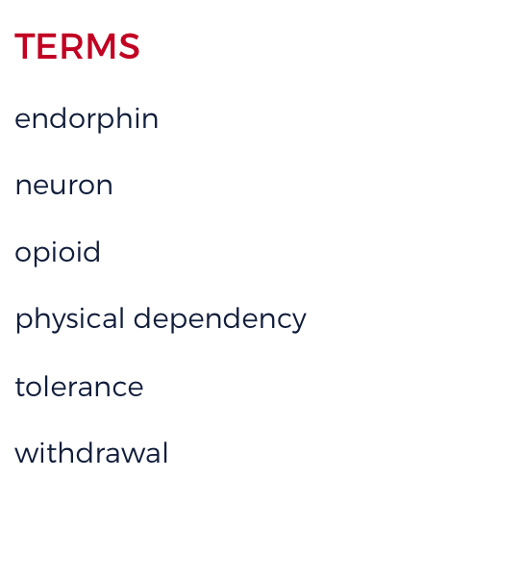
Notes:
Instructor Notes: Instruct students to match each key term on the left with its definition on the right. Then, display the correct answers.

Slide 34
True or False?
Prescription medications are safe because you can get them at the pharmacy

Slide 35
True or False?
Opioid medication is most effective when taken over a long period of time

Slide 36
True or False?
Using someone else’s opioid medication is okay as long as you are hurt

Slide 37
True or False?
Our brains cannot tell the difference between endorphins and opioids

Slide 38
True or False?
Opioid addiction is treatable

Slide 39
SAFETY TIPS
SAFETY TIPS
How to identify pills?
https://www.drugs.com/pill_identification.html
Pill Identifier and Drug List (App for your phone)
Where to dispose?
Project Medicine Drop
http://www.njconsumeraffairs.gov/meddrop
The National Prescription Drug Take Back day
https://www.deadiversion.usdoj.gov/drug_disposal/takeback/index.html
Local pharmacy take back program
http://disposemymeds.org/
Symptoms include : sweating, mydriasis (dilated pupils), vomiting, tachycardia (fast heart rate), goosebumps, abdominal cramps, muscle cramps, and involuntary leg movements
Notes:
Provide updated date for National Prescription Drug Take Back day

Slide 40
What should I do if someone I know needs HELP?
If you see or hear about someone misusing drugs, talk to a coach, teacher, or other trusted adult.
If you need information on treatment and where you can find it, you can call: Substance Abuse Treatment Facility Locator at: 1-800-662-HELP or visit findtreatment.samhsa.gov.
Notes:
Read out slide. Ask for questions.

Slide 41
Questions?
Choose one idea you learned in this lesson about opioid misuse.
1
Decide how your social media campaign will communicate the science of opioid misuse.
2
3
Write a hashtag.
4
Create an example post.
5
Submit this post to your teacher.
Notes:
Instructor Notes: Here, perhaps do a visual survey to assess the presentation

