Slide 1
Addressing the Opioid Epidemic
Orientation for Volunteers
Presented by: [Name of organization]
August 2024

Slide 2
Objectives
Discuss the current opioid epidemic
Provide overview of the organization and its goals
Describe the general role and responsibilities of a volunteer

Slide 3
What is An Opioid
Class of drug including both prescription pain medications and illicit drugs
Can cause both physical and psychological dependence
Examples:
Prescription pain medications
Natural opioids: Morphine, codeine
Semi-synthetic opioids: Oxycodone, oxymorphone, hydrocodone, hydromorphone
Synthetic opioids: methadone, fentanyl, tramadol
Illicit drugs
Heroin
1. "Opiate Abuse." DrugAbuse.com. N.p., 13 Aug. 2016. Web. 26 Jan. 2017. Available at: http://drugabuse.com/library/opiate-abuse/#signs-and-symptoms
Notes:
Reference
https://www.cdc.gov/drugoverdose/data/analysis.html

Slide 4
The Facts
Drug overdose deaths continue to increase in the United States. ¹
From 2017 to 2022, more than 500,000 people have died from a drug overdose.
Around 68% of 107,941 drug overdose deaths in 2022 involved an opioid.
In 2022, the number of overdose deaths involving opioids (including prescription opioids and illegal opioids like heroin and illicitly manufactured fentanyl) was almost 3 times higher than in 2017.
Drug overdose death has become the leading cause of injury death in the US (incidence higher than deaths caused by motor vehicle accidents)
On average, 130 Americans die every day from an opioid overdose.
Wide-ranging online data for epidemiologic research (WONDER). Atlanta, GA: CDC, National Center for Health Statistics; 2017. Available at http://wonder.cdc.gov.
Drug Overdose Death Rates. National Institute on Drug Abuse. National Institutes of Health. Available at: https://nida.nih.gov/research-topics/trends-statistics/overdose-death-rates#:~:text=Opioid%2Dinvolved%20overdose%20deaths%20rose,(Source%3A%20CDC%20WONDER).

Slide 5
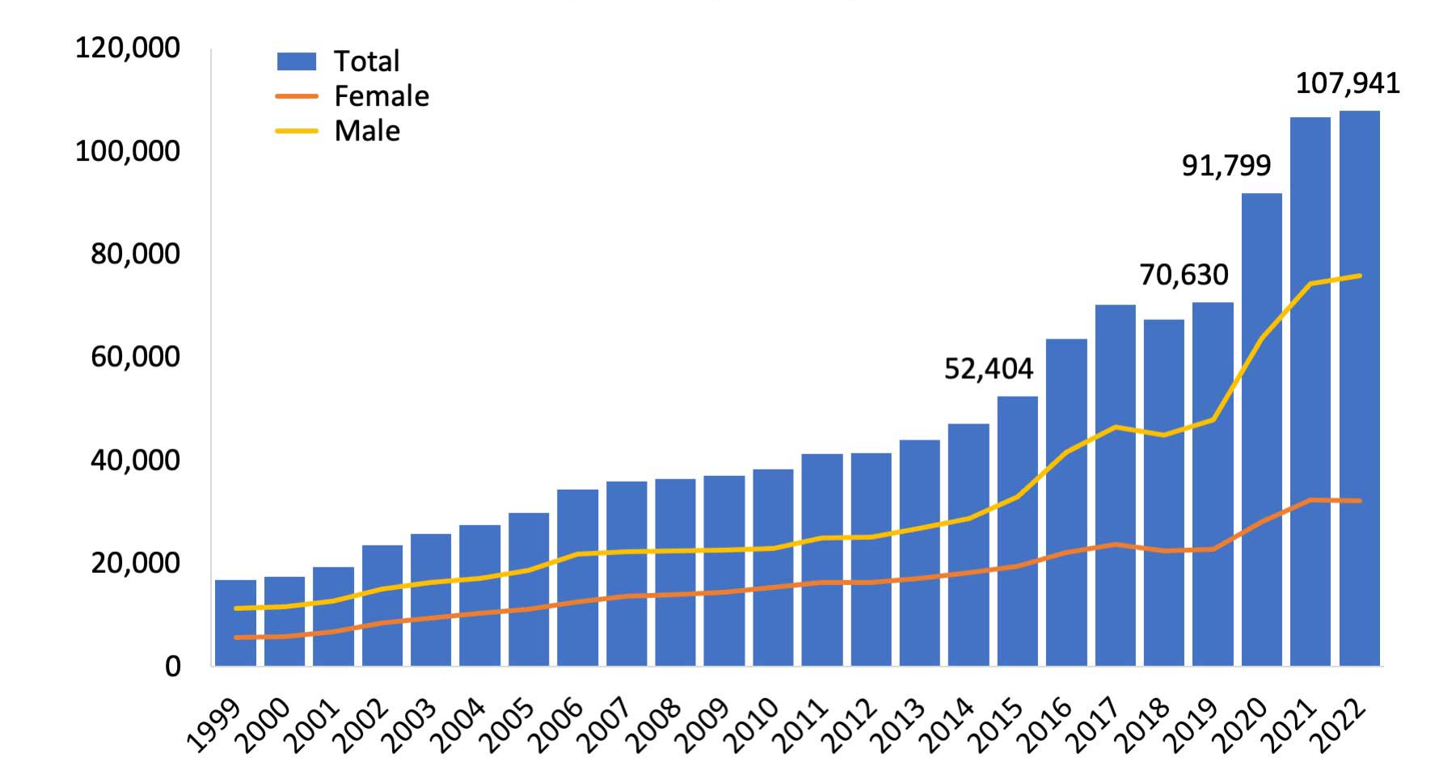
New Jersey State Specific Statistics
In 2022, there were 107,941 drug overdose deaths reported. Among these, 73,838 involved opioids.¹
Opioid-involved overdose deaths rose from 49,860 in 2019 to 81,806 in 2022.¹
Essex, Atlantic, and Camden are the three counties with the highest number of reported cases.²
Figure 1. National Drug Overdose Deaths, Number Among All Ages, by Sex 1999-2022. Source: National Institute on Drug Abuse
National Institute on Drug Abuse (NIDA): Advancing Addiction Science. National Institutes of Health 2022. May 2024.
Department of Human Services. New Jersey Drug and Alcohol Abuse Treatment Substance Abuse Overview 2022. Trenton, New Jersey. May 2024.
Notes:
https://nida.nih.gov/research-topics/trends-statistics/overdose-death-rates

Slide 6
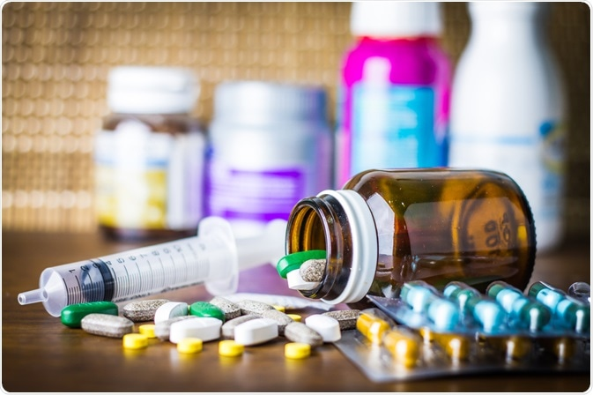
Drugs of abuse
Marijuana
Alcohol
Opioids
Methamphetamine
MDMA (Ecstasy/Molly)
Cocaine
Inhalants
Steroids
Tobacco/Nicotine
1. Commonly Abused Drugs Charts." National Institute on Drug Abuse (NIDA). N.p., 01 Jan. 2016. Web. 26 Jan. 2017. Available at: https://www.drugabuse.gov/drugs-abuse/commonly-abused-drugs-charts

Slide 7
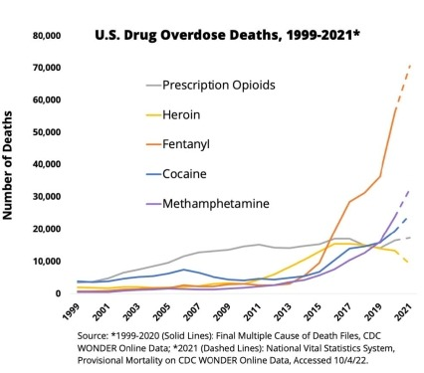
1. NIDA (2021). Nationwide Trends. Retrieved May 27, 2022. from https://nida.nih.gov/about-nida/legislative-activities/budget-information/fiscal-year-2024-budget-information-congressional-justification-national-institute-drug-abuse/ic-fact-sheet-2024

Slide 8
Prescription drug abuse
Current trend
Increased number of pain medications being prescribed
Greater social acceptance of using medications for different purposes
Risks include misuse, abuse, addiction, and overdose
One in every four chronic users of prescription opioids for non-cancer pain in primary care settings are affected by addiction
Over 1,000 people are treated in the emergency department everyday for misusing prescription opioids
1. "Prescription Opioid Overdose Data." Centers for Disease Control and Prevention. Centers for Disease Control and Prevention, 16 Dec. 2016. Web. 26 Jan. 2017.

Slide 9
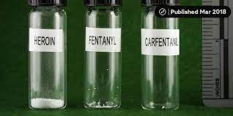
FENTANYL abuse
Increases in synthetic opioid-involved deaths are being driven by increases in fentanyl-involved overdose deaths
It is a Schedule II prescription medication that is easily made illicitly
Commonly used to lace other drugs (oxycodone, stimulants, etc.)
Anything can have fentanyl when not bought through a regulated process
Can be found in various forms, including pills
About 49% of fentanyl intercepted by law enforcement in 2023 came in pill form compared to 10% in 2017
1. “Seizures of illicit fentanyl pills have surged.” Axios. 13 May, 2024. Accessed 10 June, 2024.

Slide 10
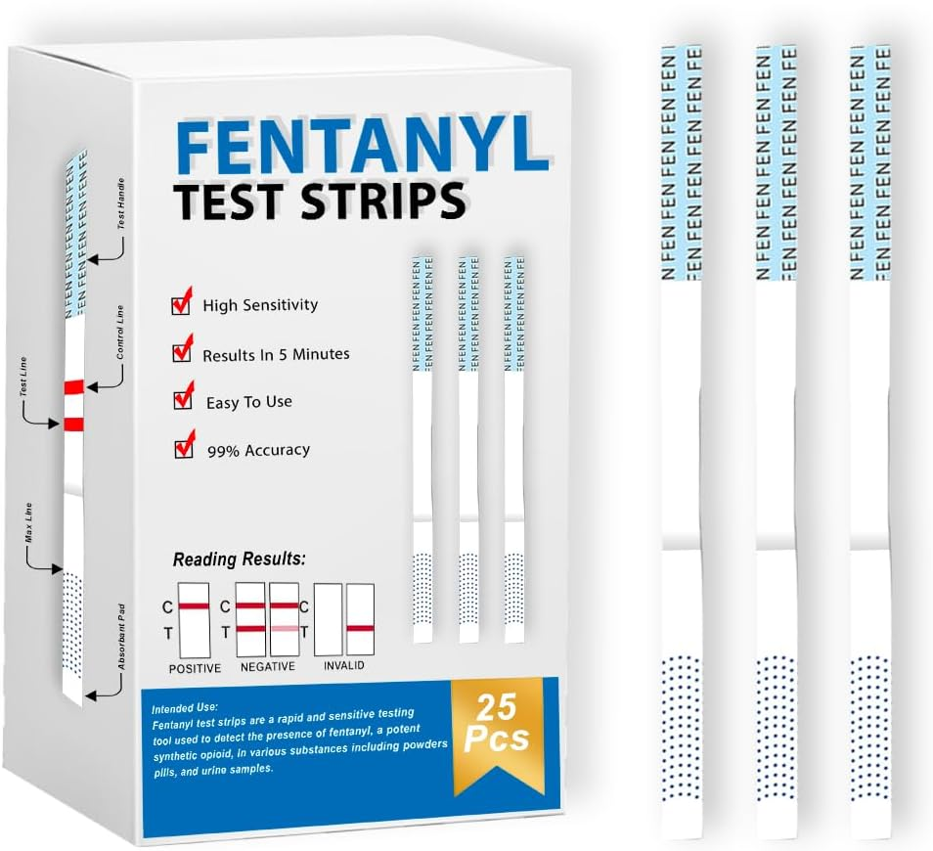
FENTANYL ABUSE
Fentanyl seizures increased 1,700% in the U.S. from 2017 to 2023
Takes a very small amount of fentanyl to lead to death
DEA has found counterfeit pills ranging from 0.02 to 5.1 milligrams (more than 2x lethal dose) of fentanyl per tablet
42% of pills tested for fentanyl contain at least 2mg of fentanyl
Drug trafficking organizations typically distribute fentanyl by kilogram (kg).
1 kg = potential to kill 500,000 people
Fentanyl test strips (FTS)
Strips of paper that can detect the presence of fentanyl in different kinds of drugs in various drug forms
“Seizures of illicit fentanyl pills have surged.” Axios. 13 May, 2024. Accessed 10 June, 2024
.”What You Can Do to Test for Fentanyl.” CDC. 2 April, 2024. Accessed 10 June, 2024.

Slide 11
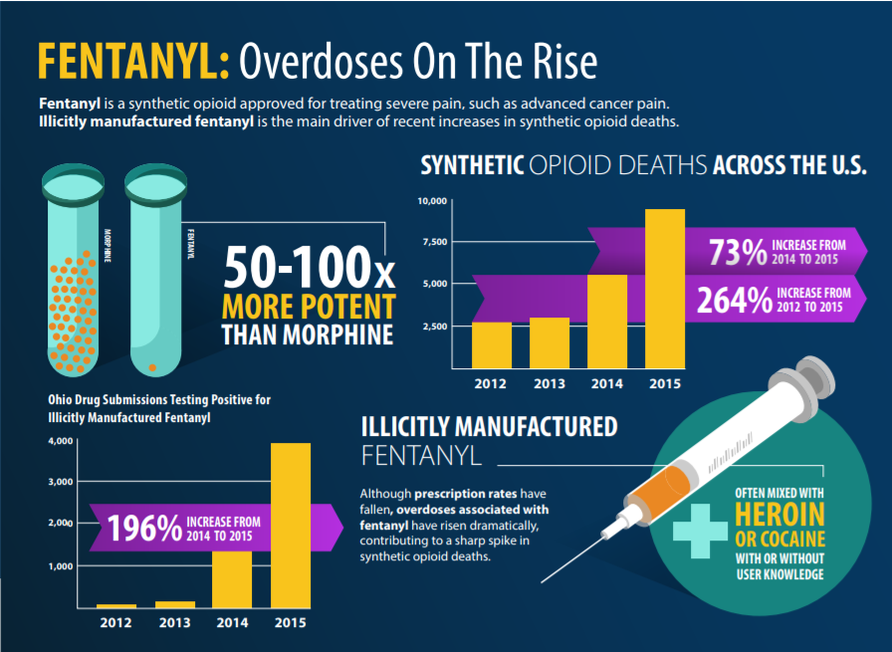

Slide 12
Acute vs. Chronic consequences of opioid use
Acute
Drowsiness & sedation
Decreased breathing
Withdrawal
Blood borne diseases through needle use
Overdose
Chronic
Tolerance
Physical and psychological dependence
Inability to maintain interpersonal relationship
Inability to maintain normal performance at work
1. Kosten, T. R., & George, T. P. (2002). The Neurobiology of Opioid Dependence: Implications for Treatment. Science & Practice Perspectives, 1(1), 13–20.

Slide 13
Recognize opioid dependence
Declined performance at work, home, or school
Loss of interest in favorite activities
Changes in eating or sleeping habits
Increased aggression or irritability
Sudden change in social network
Constantly feeling tired and sleepy
Deteriorating relationships with family members and friends
1. "Opiate Abuse." DrugAbuse.com. N.p., 13 Aug. 2016. Web. 26 Jan. 2017. Available at: http://drugabuse.com/library/opiate-abuse/#signs-and-symptoms
2. NIDA. "What to Do If Your Adult Friend or Loved One Has a Problem with Drugs." National Institute on Drug Abuse (NIDA). N.p., 19 Jan. 2016. Web. 26 Jan. 2017.Available at: https://www.drugabuse.gov/related-topics/treatment/what-to-do-if-your-adult-friend-or-loved-one-has-problem-drugs

Slide 14
Economic burden of opioid abuse
Nonmedical use of opioid pain relievers cost insurance companies up to $75.5 billion annually in health-care cost
Social & economical consequences
Cost of prevention and treatment
Increased incidences of opioid overdose deaths
Safety risk to the public due to drug affected driving
Environmental contamination due to inappropriate disposal and illicit cultivation
Loss of productivity at work
Neonatal abstinence syndrome
State and Substate Estimates of Nonmedical Use of Prescription Pain Relievers. Substance Abuse and Mental Health Services Administration (SAMHSA). July 2017. Accessed May 2024. Available at: https://www.samhsa.gov/data/sites/default/files/report_3187/ShortReport3187.html#:~:text=Prescription%20pain%20reliever%20overdoses%20have%20resulted%20in%20nearly%2015%2C000%20deaths%20since%202008.&text=Nonmedical%20use%20of%20prescription%20pain%20relievers%20costs%20health%20insurers%20up,in%20direct%20health%20care%20costs.
Notes:
https://www.samhsa.gov/data/sites/default/files/report_3187/ShortReport-3187.html#:~:text=Prescription%20pain%20reliever%20overdoses%20have%20resulted%20in%20nearly%2015%2C000%20deaths%20since%202008.&text=Nonmedical%20use%20of%20prescription%20pain%20relievers%20costs%20health%20insurers%20up,in%20direct%20health%20care%20costs.

Slide 15
Physical dependence vs. addiction
Physical Dependence
Abrupt discontinuation will result in withdrawal symptoms (nausea & vomiting, anxiety, etc.)
Addiction
Uncontrollable craving and compulsive use, inability to control drug use
There is no addiction without craving
Body is used to having a high level of opioid
Addiction is a chronic, progressive brain disease due to altered brain structure and function
1. Kosten, T. R., & George, T. P. (2002). The Neurobiology of Opioid Dependence: Implications for Treatment. Science & Practice Perspectives, 1(1), 13–20.

Slide 16
Treatment options
Best treatment option is PREVENTION!
Counseling & Behavioral Therapies
Individual and group counseling
Inpatient and residential treatment
Intensive outpatient treatment
Case or care management
Recovery support services
12-step fellowship
Peer supports
Medication Assisted Treatment
Buprenorphine
Methadone
Naltrexone
1. "Treatment for Substance Abuse Disorders." SAMHSA. N.p., 8 Sept. 2016. Web. 26 Jan. 2017. Available at: https://www.samhsa.gov/treatment/substance-use-disorders

Slide 17
Take Home Points
Prescription opioids is just as dangerous as illicit drugs when not taken as directed
Prescription opioid abuse is strongly linked to heroin abuse
Opioid addiction is a disease which requires treatment
The best treatment for opioid addiction is prevention

Slide 18
Available resources
National 24/7 Helpline: 1-800-662-HELP (4357)
New Jersey Addiction Services 24/7 Hotline: 1-844-276-2777
Substance Abuse and Mental Health Services Administration: 1-800-662-4357
https://www.samhsa.gov

Slide 19
[INSERT YOUR ORGANIZATION NAME HERE]
Use this section to briefly introduce your organization, your goals/mission statements, and upcoming events

Slide 20
Volunteers
Use this section to introduce your expectations of your volunteers, and describe their roles & responsibilities

