Slide 1
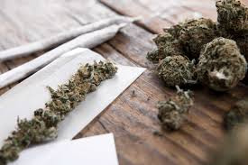
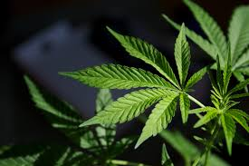
Marijuana

Slide 2
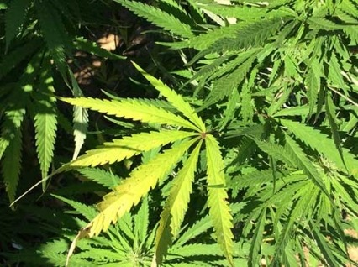
What Is Marijuana?
Marijuana: dried leaves, flowers, stems, and seeds from Cannabis Sativa or Cannabis indica plant
Street Names: weed, pot, dope, Mary Jane, grass, reefer, herb
Smoked in hand-rolled cigarettes (joints), pipes, water pipes (bongs), or emptied cigars refilled with marijuana (blunts)
Sometimes mixed with various foods to create “edibles”
Notes:
https://nida.nih.gov/publications/drugfacts/cannabis-marijuana

Slide 3
MYTH OR FACT???
Marijuana stays only in the lungs and will not test positive on a blood test!

Slide 5
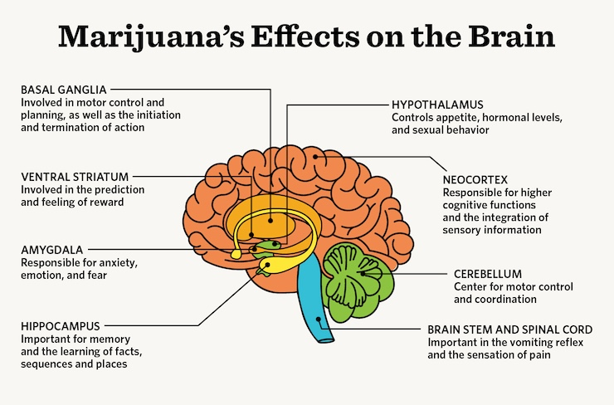
How Does It Work?
(1) The plant contains a mind-altering chemical, THC, and other similar compounds
(2) THC passes from lungs into blood stream
(3) The blood carries the chemical to the brain and other organs in the body
(4) THC causes a "high" that affects coordination, memory, pleasure, and judgement
Notes:
https://nida.nih.gov/publications/drugfacts/cannabis-marijuana

Slide 6
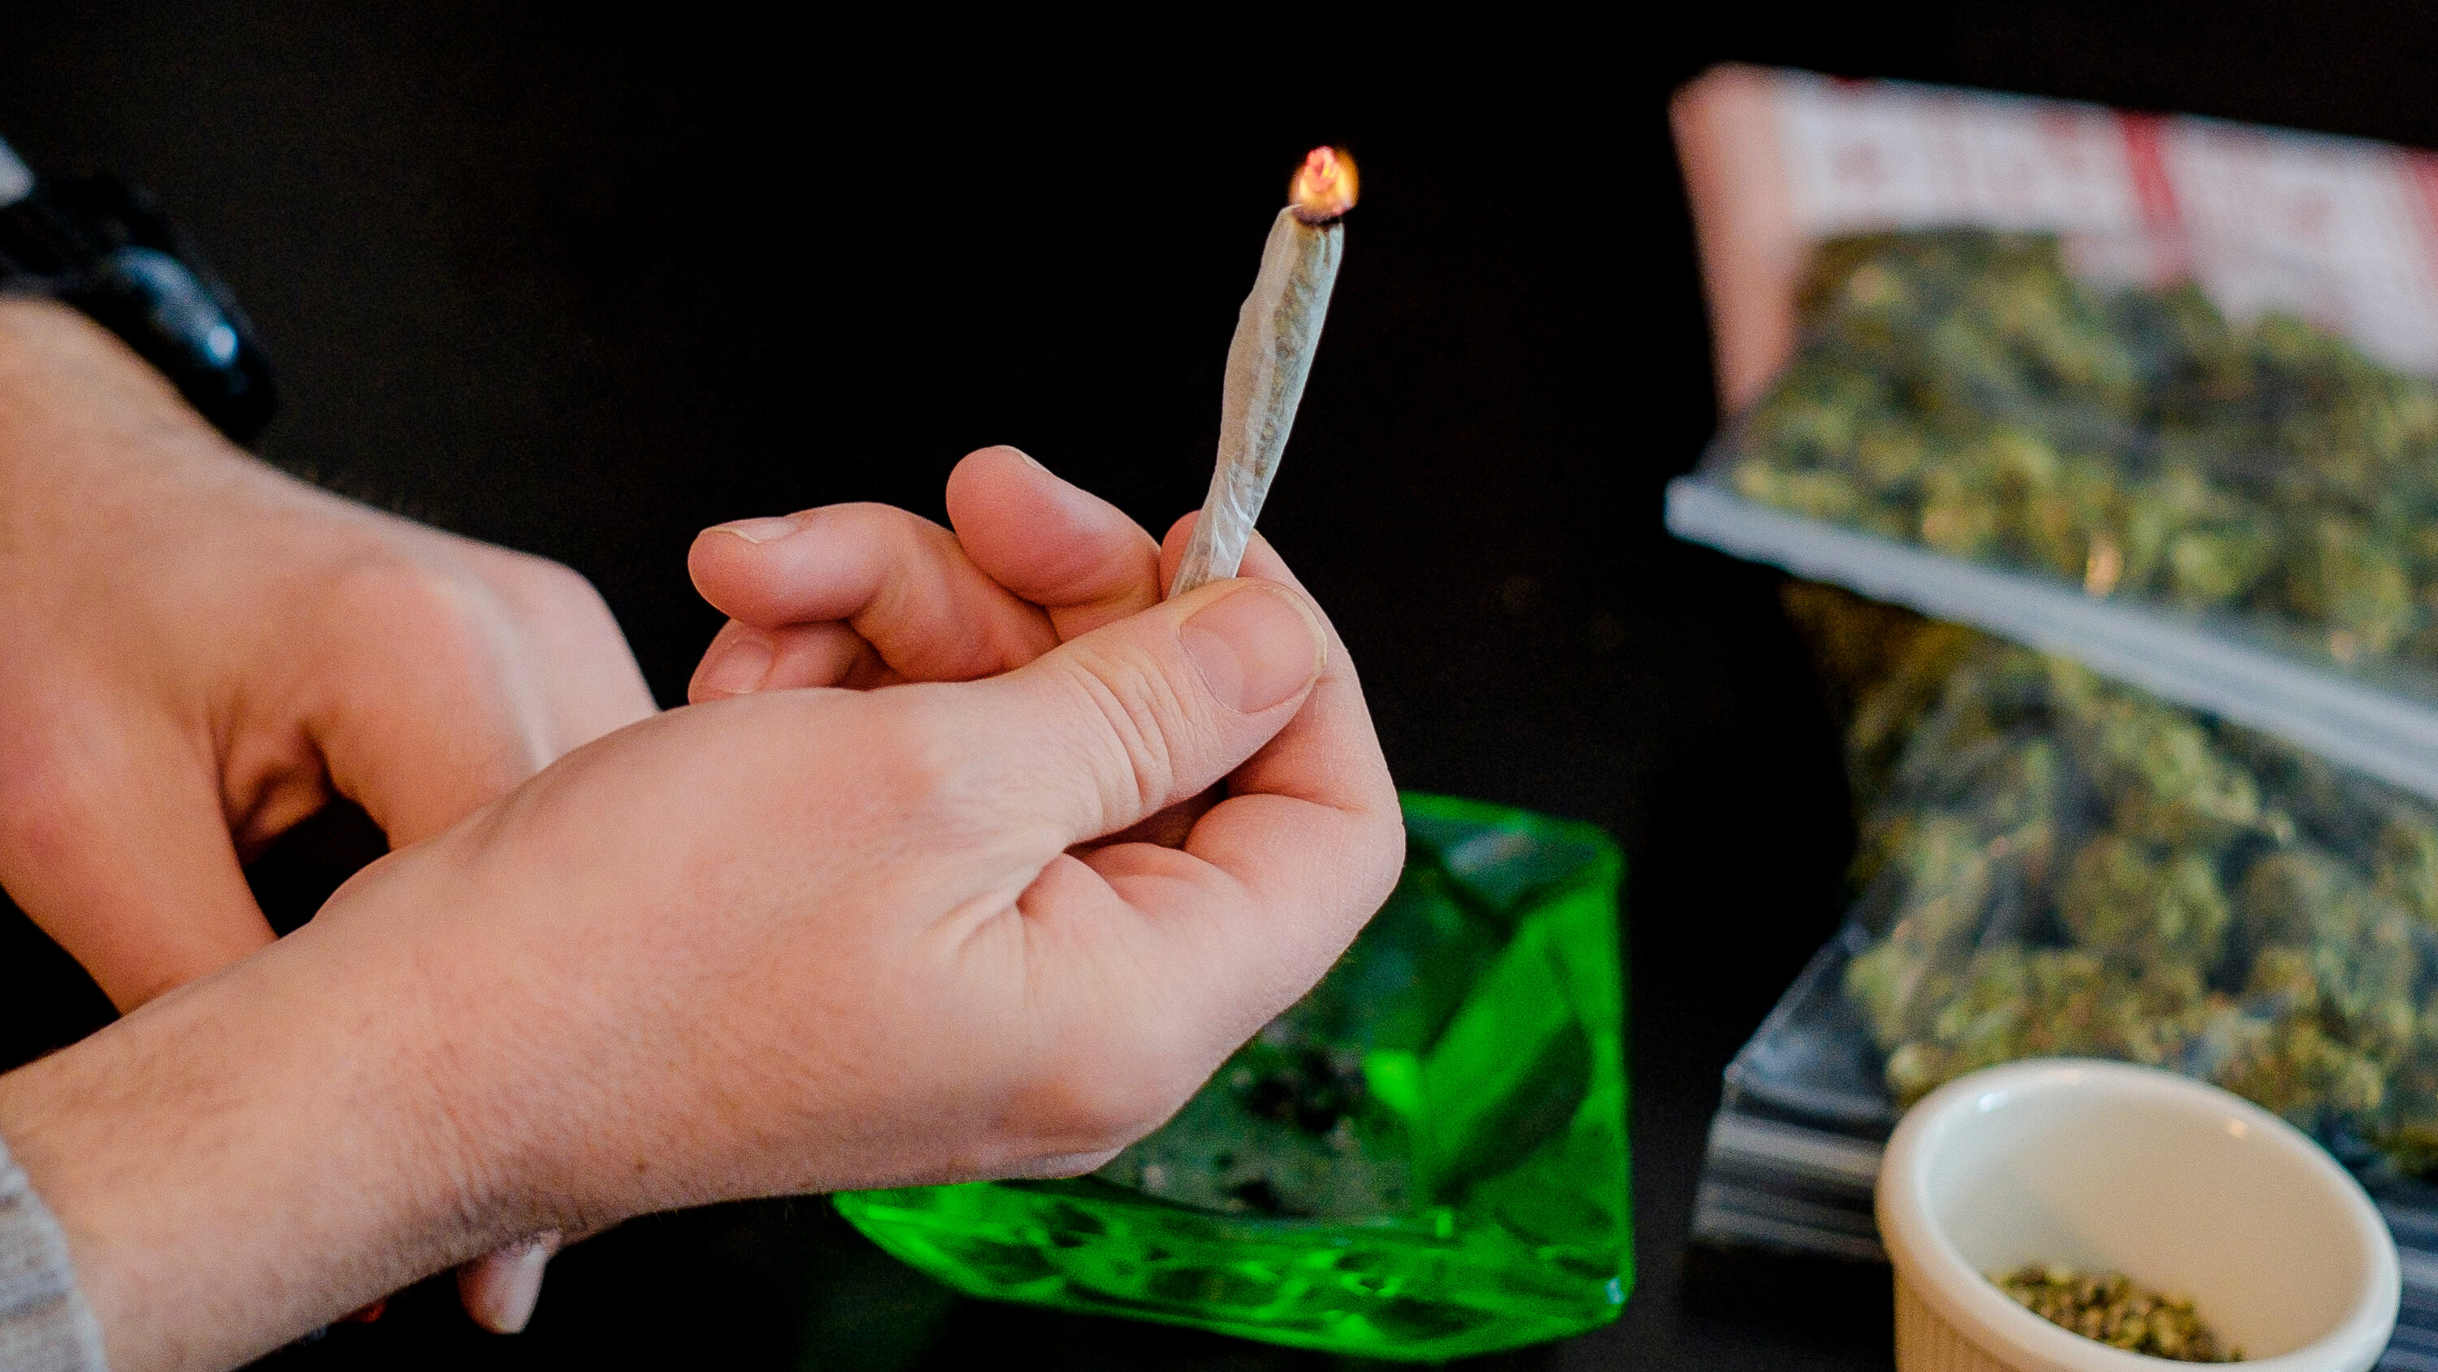
Did You Know?
In 2021, 11.8 million young adults ages 18 to 25 reported using marijuana within the past year
In 2022, 20.7% of 12th graders reported using marijuana in the past year and 6.3% reported using marijuana daily
In 2022, nearly 20.6% of 12th graders reported that they vaped marijuana in the past year and 2.1% reported doing so daily
Notes:
https://nida.nih.gov/publications/drugfacts/cannabis-marijuana

Slide 7
What Do These Celebrities Have In Common?
Notes:
(1) Lady Gaga
(2) Brad Pitt
(3) Miley Cyrus
(4) Woody Harrelson
(5) Snoop Dog
(6) Jennifer Lawrence
Even though so many people use marijuana, they face negative consequences
All celebrities used to smoke a lot and stopped
All faced effects on their mental and physical health, now advocating how it slowed down their motivation and working abilities

Slide 8
Short Term Effects
Changed senses (smell, taste, etc.)
Changes in mood
Change body movement (imbalance, uncoordinated)
Difficulty thinking and problem-solving
Impaired memory
Hallucinations
Delusions
Psychosis (do not know real from fake)
Notes:
https://nida.nih.gov/publications/drugfacts/cannabis-marijuana
https://my.clevelandclinic.org/health/articles/4392-marijuana-cannabis

Slide 9
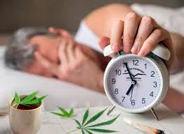
Long Term Effects
Brain development
Psychological disorders (cognitive impairment, anxiety, paranoia, and increased risk of psychosis)
Loss of attention
Loss of memory
Decline of immune system
Notes:
https://nida.nih.gov/publications/drugfacts/cannabis-marijuana
Marijuana affects brain development: when people use marijuana at younger ages, the drug may impair their thinking, memory, and learning functions. It may also affect how the brain builds connections between the areas necessary for these functions.
Long term effects are still being continued to be studies as marijuana's use is becoming more prevalent.

Slide 10
MYTH OR FACT???
Long-term marijuana use can cause severe episodes of nausea and vomiting

Slide 12
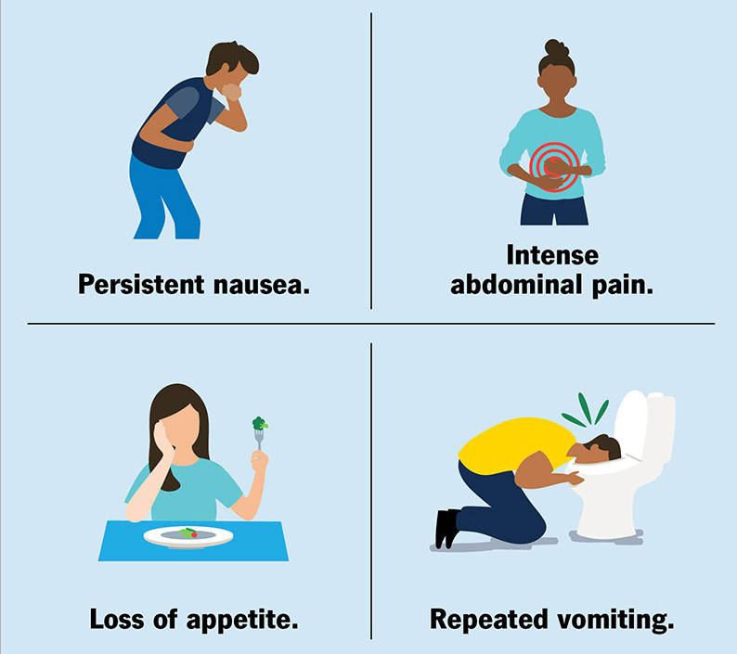
Cannabinoid Hyperemesis Syndrome
Affects long-term cannabis users
Frequent cycles of severe nausea, vomiting, and abdominal pain
May cause up to 30 vomiting episodes daily
Temporarily relieve symptoms with hot baths and shower
Symptoms can come back after starting to use marijuana again
Notes:
https://my.clevelandclinic.org/health/diseases/21665-cannabis-hyperemesis-syndrome

Slide 13
MYTH OR FACT???
Marijuana is NOT an addictive substance.

Slide 15
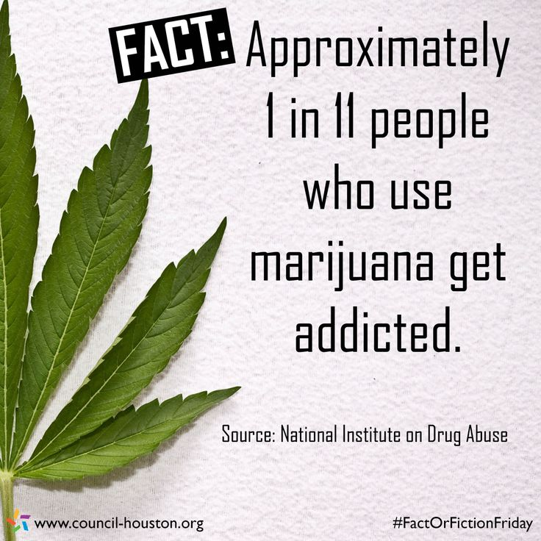
Signs and Symptoms of Addiction
Social withdrawal (tired, disconnected)
Ignoring dangers and risk
Cravings
Frustration
Trouble in school, work, or relationships
Disregarding problems
Disproportionate focus
Notes:
https://americanaddictioncenters.org/marijuana-rehab/signs-of-abuse

Slide 16
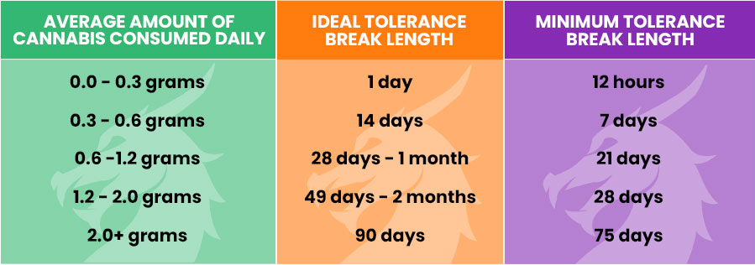
Tolerance
Regular use of marijuana can lead to tolerance development
Tolerance = requiring more drug to achieve the same effects or "high"
"Tolerance Breaks" are recommended for users to restore balance and lower the tolerance
Ideal break= ~21 days
Notes:
https://pubmed.ncbi.nlm.nih.gov/828472/

Slide 17
Withdrawal
Symptoms:
Anger, irritability, and aggression
Nervousness and anxiety
Restlessness
Decreased appetite or weight
Depression
Insomnia
Strange or unsettling dreams
Headaches, nausea, vomiting, sweating, and abdominal pain
Tremors
Notes:
https://americanaddictioncenters.org/withdrawal-timelines-treatments/weed-marijuana

Slide 18
MYTH OR FACT???
Marijuana can be used as treatment for certain medical conditions

Slide 20
Medical Marijuana
Ease symptoms from medical conditions
Cannabidiol with <0.3% THC is legal under federal law for medical purposes
Can be used for:
Glaucoma
Multiple Sclerosis and Muscle Spasms
Posttraumatic Stress Disorder (PTSD)
Serious and Ongoing Pain
Serious Nausea/ Vomiting from Cancer Treatment
Alzheimer's Disease
Amyotrophic Lateral Sclerosis (ALS)
HIV/AIDS
Crohn's Disease
Epilepsy and Seizures
Varies by state
Inhalation, oral, sublingual, rectal, and topical forms available
Must be prescribed by a provider, not available at a marijuana dispensary
Notes:
https://www.mayoclinic.org/healthy-lifestyle/consumer-health/in-depth/medical-marijuana/art-20137855

Slide 21
MYTH OR FACT???
Marijuana has no negative effects on mental health.

Slide 23
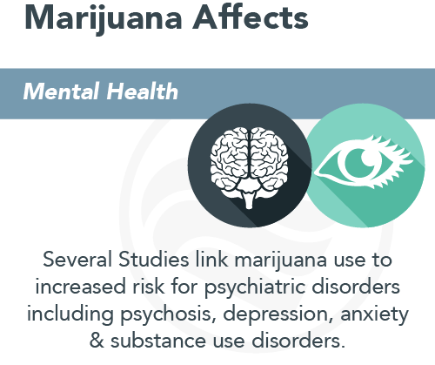
Mental Health
Regular marijuana use is linked to increased risk of anxiety and depression, and possibly psychotic illnesses
Affects how well you think and your concentration
Affects motivation
Notes:
https://nida.nih.gov/publications/drugfacts/cannabis-marijuana

Slide 24
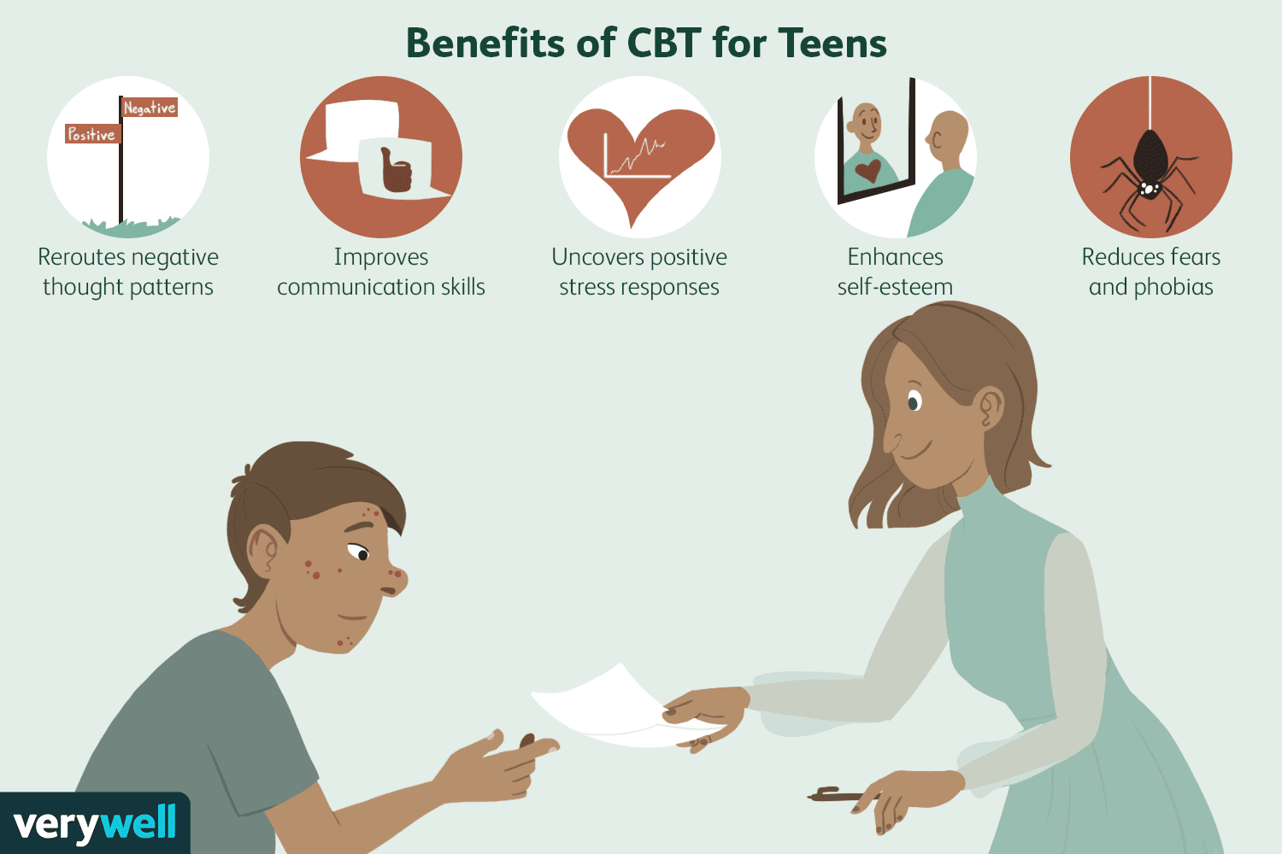
Treatments
Cognitive Behavioral Therapy (CBT)
Motivational Enhancement Therapy (MET)
Group/Individual Therapy
Rehabilitation Programs
Pharmacological Medications for Withdrawal Symptoms
Notes:
https://americanaddictioncenters.org/marijuana-rehab

Slide 25
How to Get Help
Rehabilitation Centers: https://americanaddictioncenters.org/treatment-centers
Substance Abuse and Mental Health Services Administration (SAMHSA) National Helpline: 1-(800)-662-4357
American Addiction Centers Helpline: (866)-959-6117
Reach out to local hospital or call 911 for emergencies
Notes:
https://www.samhsa.gov/find-help/national-helpline
https://americanaddictioncenters.org/marijuana-rehab

Slide 26
Questions?

